Slide 1
How to do a good research
Part I
Chun-Wei Tsai
Notes:
1

Slide 2
Online
Before you start writing a paper
Do a survey and make a note that is a summary of the survey
Come up with a plan for your research career
How to write a good paper
What is next?
Notes:
2

Slide 3
1. Before you start writing a paper
Notes:
3

Slide 4
Survey (1/2)
Keywords selection
Internet of Thigns, IoT, IoTs ➔ wireless sensor network, WSN
How to find out papers that you need
Google Scholar
IEEE Xplore Digital Library
ScienceDirect.com
ACM Digital Library
Notes:
4

Slide 5
Survey (2/2)
What is a good paper?
High citations, e.g., # of citations > 100
Published on a good journal or top conference, e.g., IEEE Trans., ACM SIG conference. Note that not all the papers published on IEEE conference are good paper.
It provides a systematic description about the whole research topic, e.g., a survey paper.
It presents a state-the-art method.
It defines a new problem.
A new or interesting solution or application.
Notes:
5

Slide 6
Summary
After reading 10 to 20 papers
You have to pick up one or two important research topics.
Then, find more papers on the selected topic(s) and read them.
Make a summarization and compare these papers, e.g., advantages vs. disadvantages.
Think about your method based on the summarization you made. For example, if most algorithms are slow for a problem, then how can I accelerate them or provide a new algorithm to solve this problem?
Notes:
6

Slide 7
A plan
What kind of research you want to do?
Write a survey paper.
Present a brand-new method.
Reduce the computation time or improve the end result by modifying the existing algorithm.
A practical application with advanced technologies for hot topics, such as edge computing.
Notes:
7

Slide 8
How to modify the existing algorithm
Hybrid algorithm, i.e., algorithm that combines two different algorithms to enhance the performance of the original algorithm.
Modify the operator of the soft computing algorithm
Initialization
Transition operator
Evaluation operator
Determination operator
Modify the whole search process, parallel computing
The most important thing, however, is that you need to know which of them may be able to enhance the performance of the soft computing algorithm.
Notes:
8

Slide 9
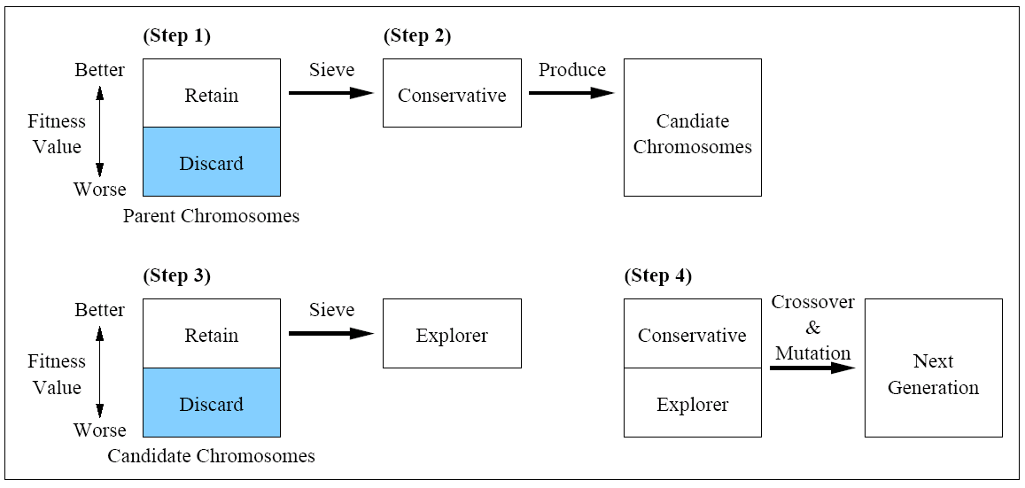
Three examples (1/6)
Multiple-search genetic algorithm (MSGA), 2002, Master student
Modify the search process.
Notes:
9

Slide 10
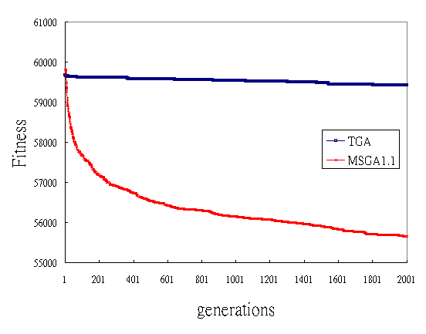
Three examples (2/6)
Simulation results on the traveling salesman problem
TSP problem pcb442
Notes:
10

Slide 11
Three examples (3/6)
Pattern Reduction, 2007, PhD student
C₁
0
0
1
0
C₁
0
0
1
0
g=1, s =4
C₂
g =1, s =4
C₂
1
1
1
0
1
1
1
0
C₁
0
0
1
0
C₁
0
0
g =2, s =4
g =2, s =2
C₂
1
1
1
0
C₂
1
1
.
.
.
.
.
.
C₁
0
0
1
0
C₁
0
0
g =n, s =4
g =n, s =2
C₂
1
1
1
0
C₂
1
1
Metaheuristics
Metaheuristics
+
Pattern Reduction
Notes:
11

Slide 12
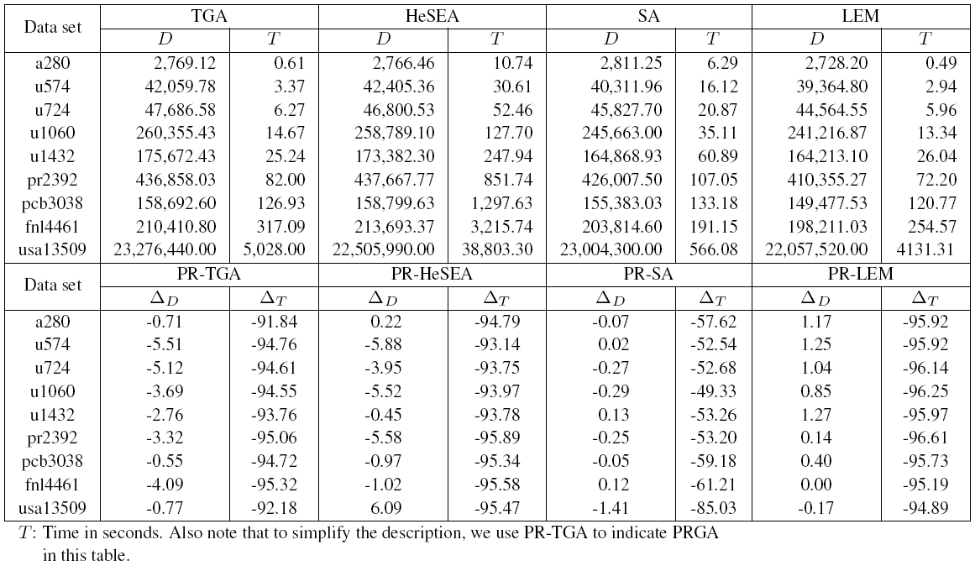
Three examples (4/6)
Simulation results on the traveling salesman problem
Notes:
12

Slide 13




Three examples (5/6)
Search Economics, 2015, Assistant Professor.
fitness value
t₂
iteration
Notes:
13

Slide 14
Three examples (6/6)
Simulation Results
SE can find the optimum solution
in 4,895 iterations on average.
Chun-Wei Tsai, “Search Economics: A Solution Space and Computing Resource Aware Search Method,” IEEE International Conference on Systems, Man and Cybernetics (SMC 2015), pp. 2555-2560, 2015.
14
Notes:
14

Slide 15
2. How to write a good paper
Notes:
15

Slide 16
Abstract
Problem
Solution
Results
Notes:
16

Slide 17
Introduction
An overall description of the research topic
Its importance
Marketing, applications, hot research topics, etc.
Which problem of this research topic needs to be solved
Your main contribution
Organization
Notes:
17

Slide 18
Related Work
Notations
Problem definition
Discussions of relevant works
Summary
Notes:
18

Slide 19
The Proposed Algorithm
The basic idea
The proposed algorithm
A simple example
Notes:
19

Slide 20
Simulation Results
Environment
Data sets and parameter settings
Impact of parameters
Results
Complexity analysis
Notes:
20

Slide 21
Conclusion
Summarization
Future work
Notes:
21

Slide 22
References
Journal
Authors’ Name, “Title,” Journal, vol. 1, no.1, pp.1-10, 2017.
Conference
Authors’ Name, “Title,” in Proceedings of the Conference, pp.1-10, 2017.
Book
Authors’ Name, “Title,” Publisher, USA, 2017.
Technical Report
Authors’ Name, “Title,” Available at http://www.rfidjournal.com/, 2017.
Notes:
22

Slide 23
Writing issues (1/3)
() and “,”
Genetic algorithm (GA) (O)
Genetic algorithm(GA) (X)
A and B (O) A, and B (X)
A, B, and C (O) A, B,and C (X)
Authors
One author, e.g., Tsai presented ….
Two authors, e.g., Tsai and Chiang presented ….
More than two authors, Tsai et al. presented …
Notes:
23

Slide 24
Writing issues (2/3)
Avoid using adverb at the beginning of a sentence too often.
Moreover, ….
Besides, ….
In addition, …..
Avoid using too many “we” in the text.
An inverted sentence will be fine.
We will present an effective algorithm in this paper. ➔
An effective algorithm will be presented in this paper.
Notes:
24

Slide 25
Writing issues (3/3)
Avoid a long sentence in your paper.
Try to split it into a few sentences each of which talks about one thing.
Make sure that everything in your paper is consistent.
symbols, references, descriptions, and so on.
Use a simple description to explain your idea.
Make sure that symbols are in italic and compose of only one letter.
energy_{i} (x)
E_{i} (o)
Notes:
25

Slide 26
3. What is next?
Notes:
26

Slide 27
Things that you need to learn
Use emacs and LaTeX instead of MS word to write a paper.
Use gnuplot to draw the results.
Use xfig or visio to draw the figure.
Use Linux as the OS
Understand how to submit a paper to a conference or journal. This is something that you need to know after you finished writing a paper.
Reviewing process.
Revision strategies.
Notes:
27

Slide 28
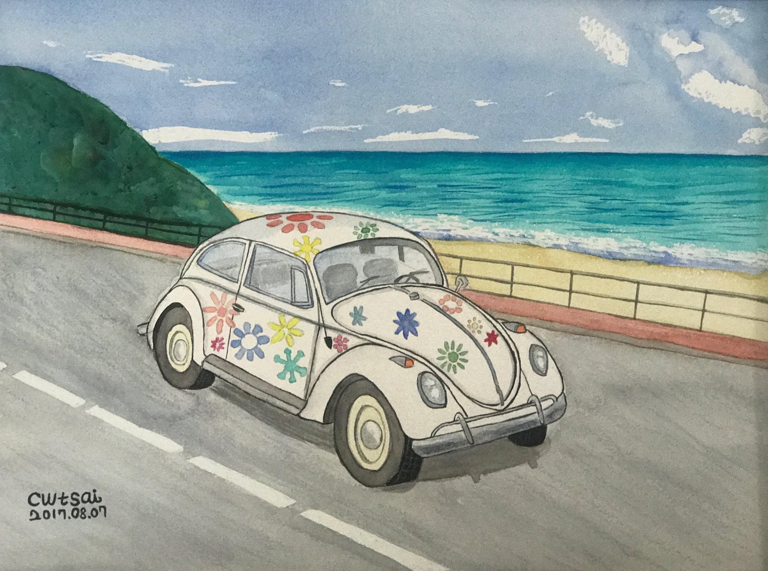

Thank You ;-)
Notes:
28

